Slide 1
Subscribers Galore Exploring World’s Top YouTube Channels
DR.KALAIGNAR GOVERNMENT ARTS COLLEGE-KULITHALAI
KARUR
FACULTY MENTOR
MRS. C. REVATHI., M.sc., M. Phil., B.Ed.,
Guest Lecturer

Slide 2
TEAM MEMBERS
L.SAGADEVAN – TEAM LEADER
P.SATHIYARAJ – TEAM MEMBER
A.SATHIYAMOORTHY – TEAM MEMBER
K.SANGEETHA – TEAM MEMBER

Slide 3
INTRODUCTION
Welcome to Subscribers Galore: Exploring the World's Top YouTube Channels! In this exciting journey, we will develop into the captivating and diverse realm of YouTube content creators who have amassed millions of subscribers. Join us as we uncover the secrets to their success, explore their unique niches, and discover the fascinating stories behind these internet sensations. Whether you're a YouTube enthusiast, aspiring content creator, or just curious about the online world, this is the ultimate guide to the most influential and entertaining channels on the planet. Subscribe, sit back, and let's embark on a thrilling adventure through the YouTube universe!

Slide 4
PURPOSE
Entertainment: YouTube is a major source of entertainment, hosting a wide variety of content, including music videos, vlogs, skits, and more, which cater to a global audience's diverse.
Education: Many creators use YouTube to share educational content, offering tutorials, online courses, and informational videos on a wide range of subjects, making it a valuable learning resource.
Communication: YouTube allows individuals and organizations to communicate their messages, ideas, and opinions to a broad audience. It's a powerful tool for advocacy, marketing, and social or political commentary.
Monetization: For content creators, YouTube offers opportunities for monetization through advertising revenue, sponsorships, merchandise sales, and paid subscriptions to their channels.
Community Building: Creators can build communities around their content, fostering interaction, discussion, and a sense of belonging among their viewers through comments, likes, and shares.
Documentation: YouTube serves as a platform for documenting personal experiences, travel adventures, and historical events, allowing individuals to preserve and share their memories.
Business and Brand Promotion: Many businesses and brands use YouTube for marketing, product demonstrations, and brand promotion, reaching a vast customer base.
News and Information: News organizations and individuals use YouTube to report news, share updates, and provide commentary on current events, contributing to the dissemination of information.
Artistic Expression: YouTube enables artists, musicians, and creators to showcase their talents and creative works, broadening their exposure and connecting with a global audience.
Social Connection: YouTube's comment sections and community features provide a platform for viewers to connect, discuss, and share their thoughts, fostering a sense of community and social interaction.

Slide 5
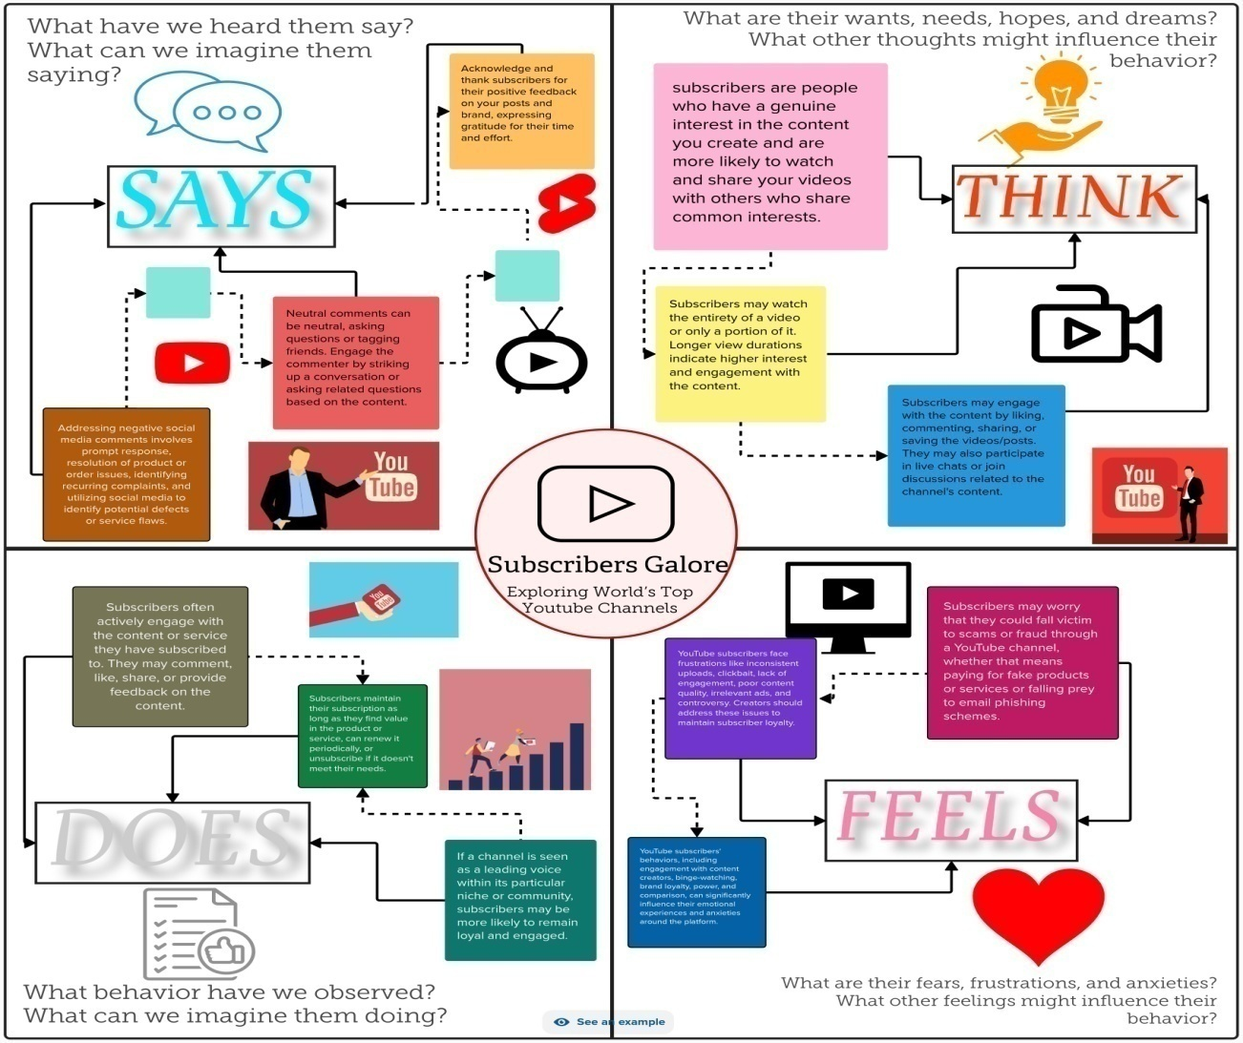
EMPATHY MAP

Slide 6
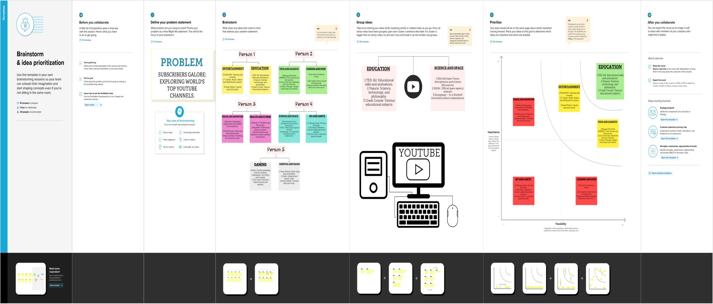
BRAINSTORM

Slide 7
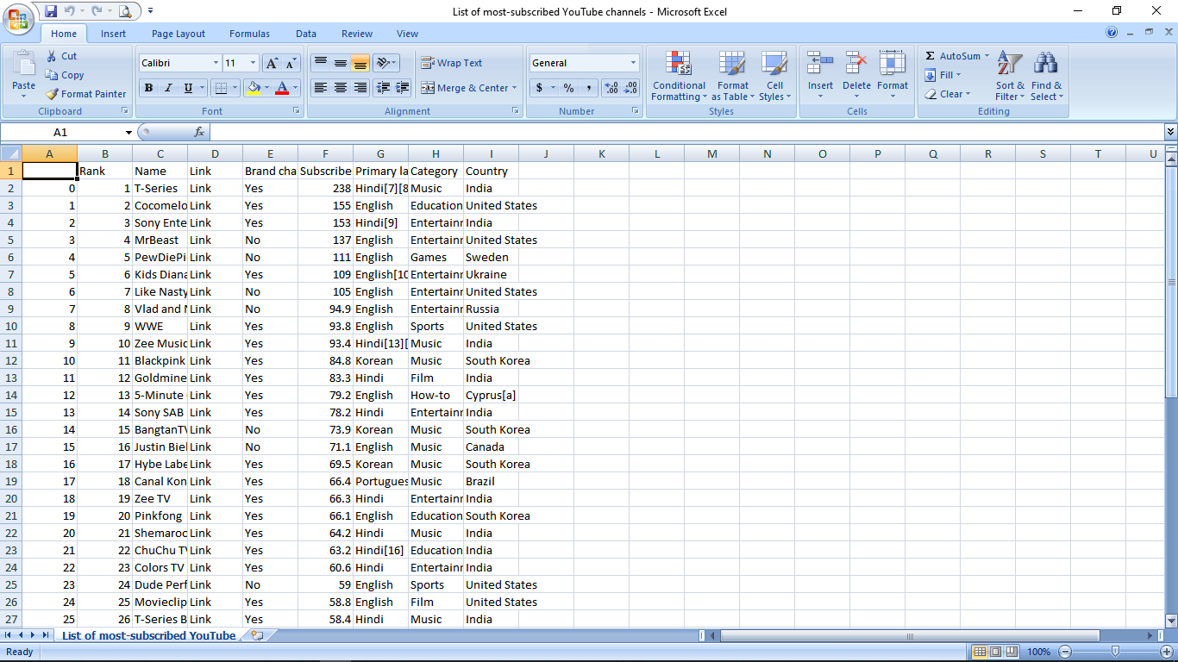
DATA SET

Slide 8
ABOUT DATA SET
Rank – The overall rank of the YouTube channels.
Name – The name of the YouTube channels.
Primary language – The several language of the YouTube channels.
Category – The category of the YouTube channels.
Subscribers – The number of peoples who is subscribe the channel.
Notes:
oo

Slide 9
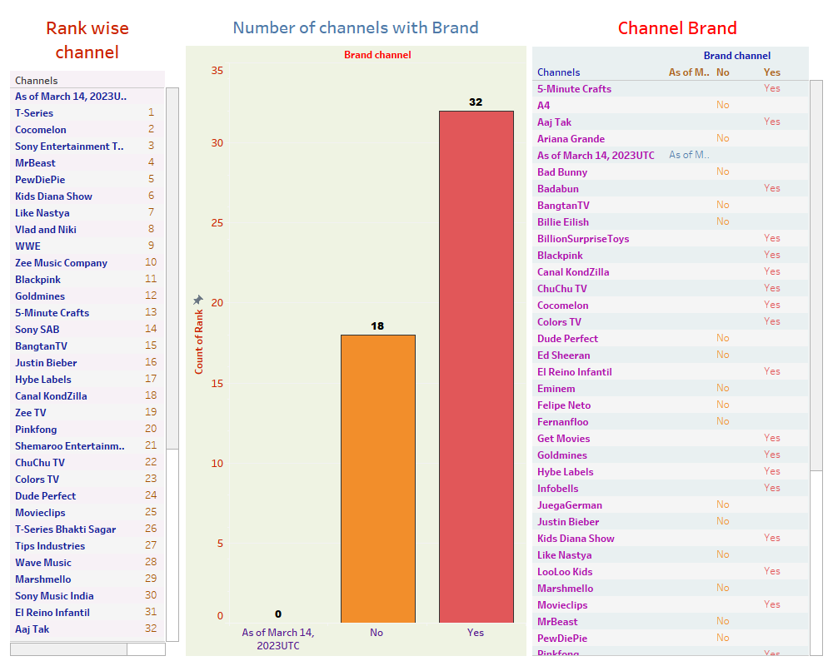
DASHBOARD 1

Slide 10
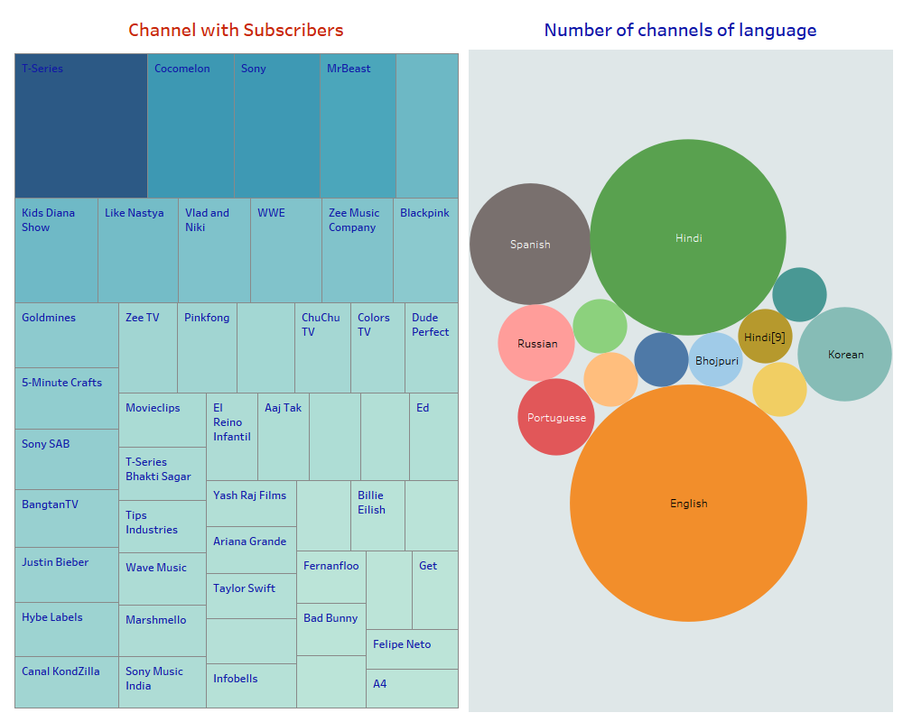
DASHBOARD 2

Slide 11
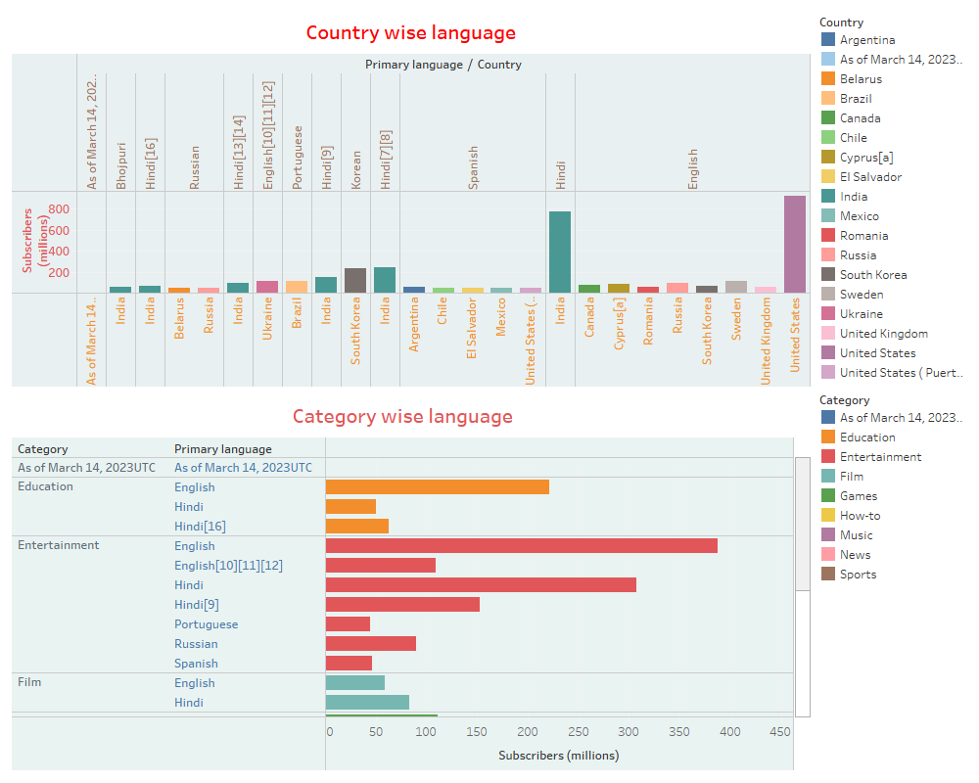
DASHBOARD 3

Slide 12
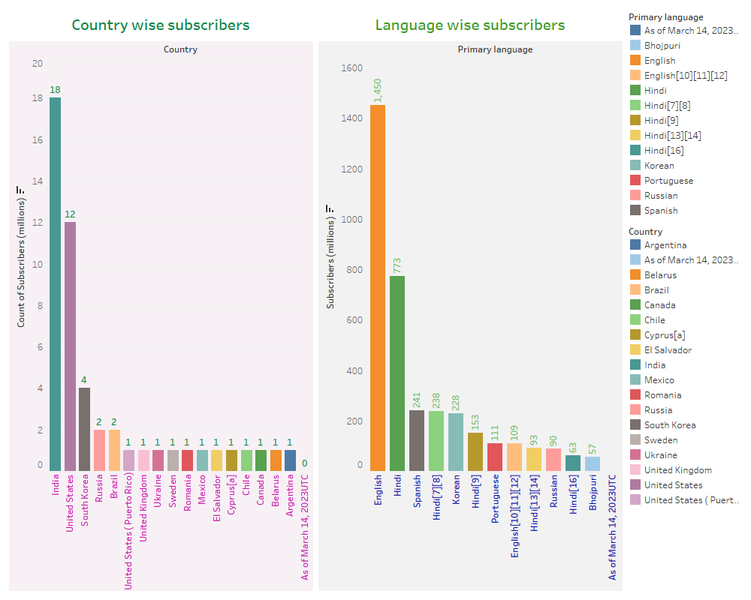
DASHBOARD 4

Slide 13
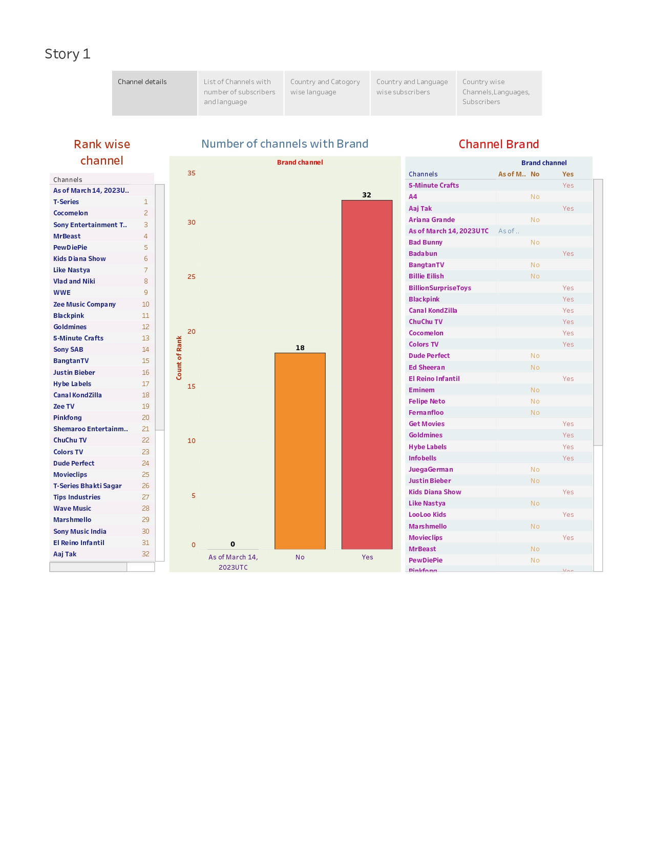
STORY CAPTION 1

Slide 14
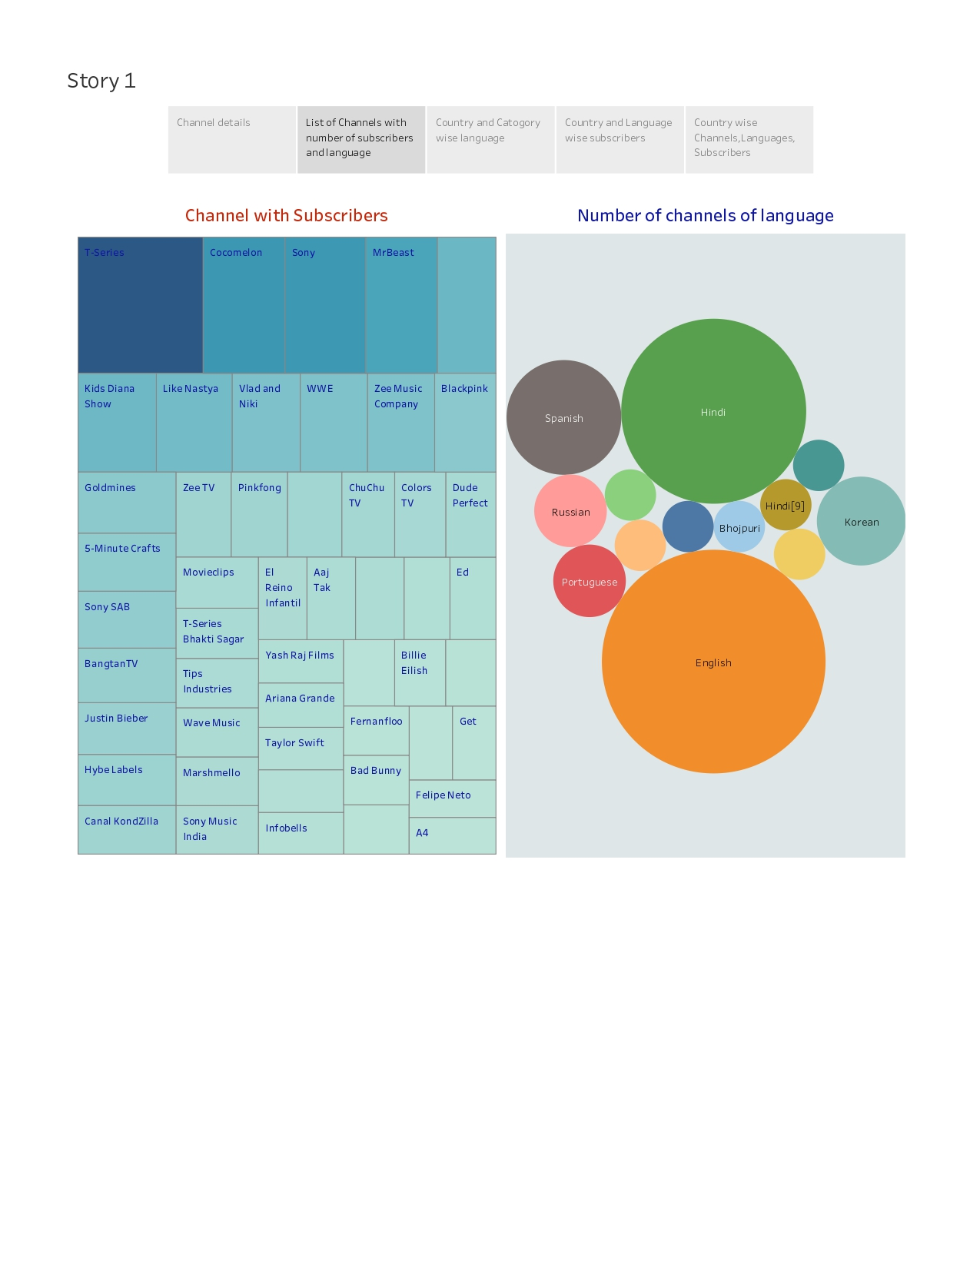
STORY CAPTION 2

Slide 15
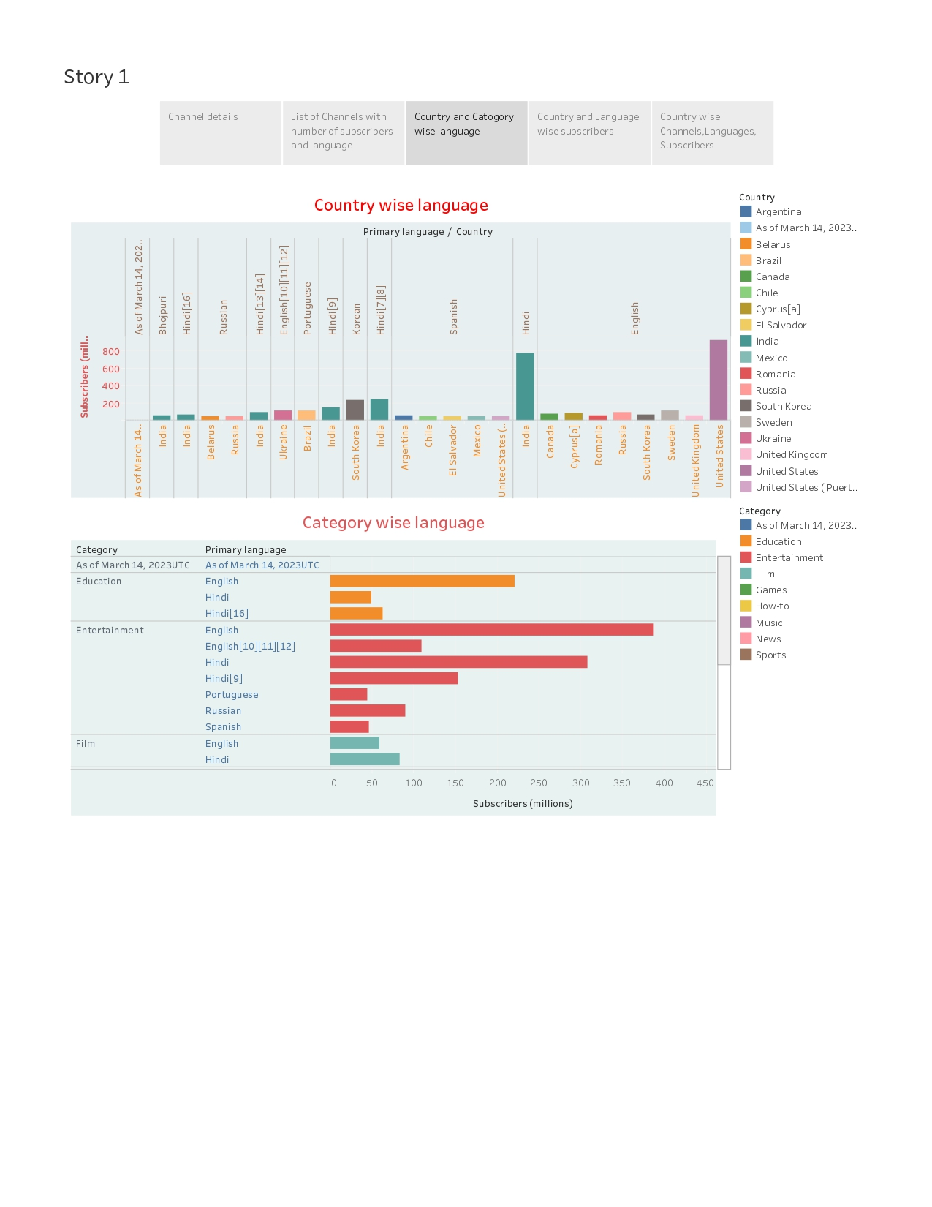
STORY CAPTION 3

Slide 16
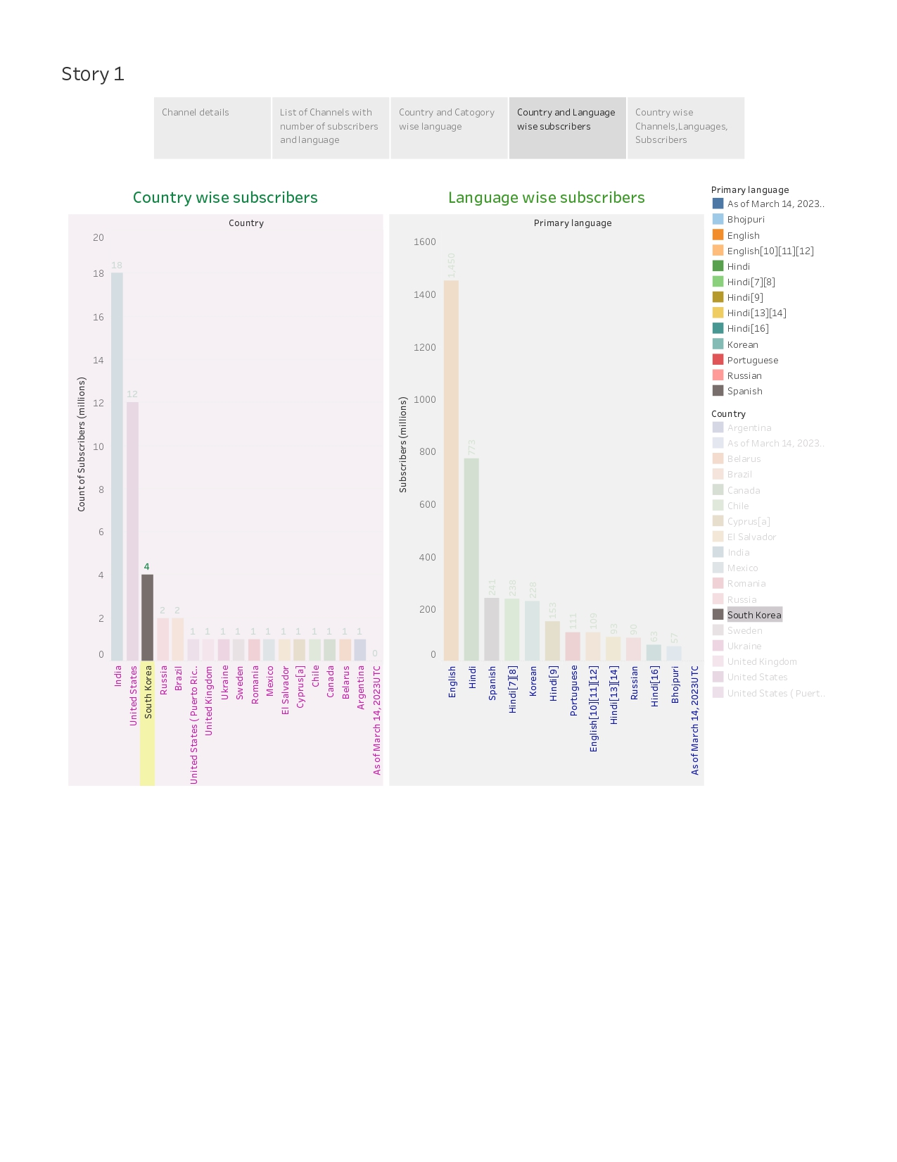
STORY CAPTION 4

Slide 17
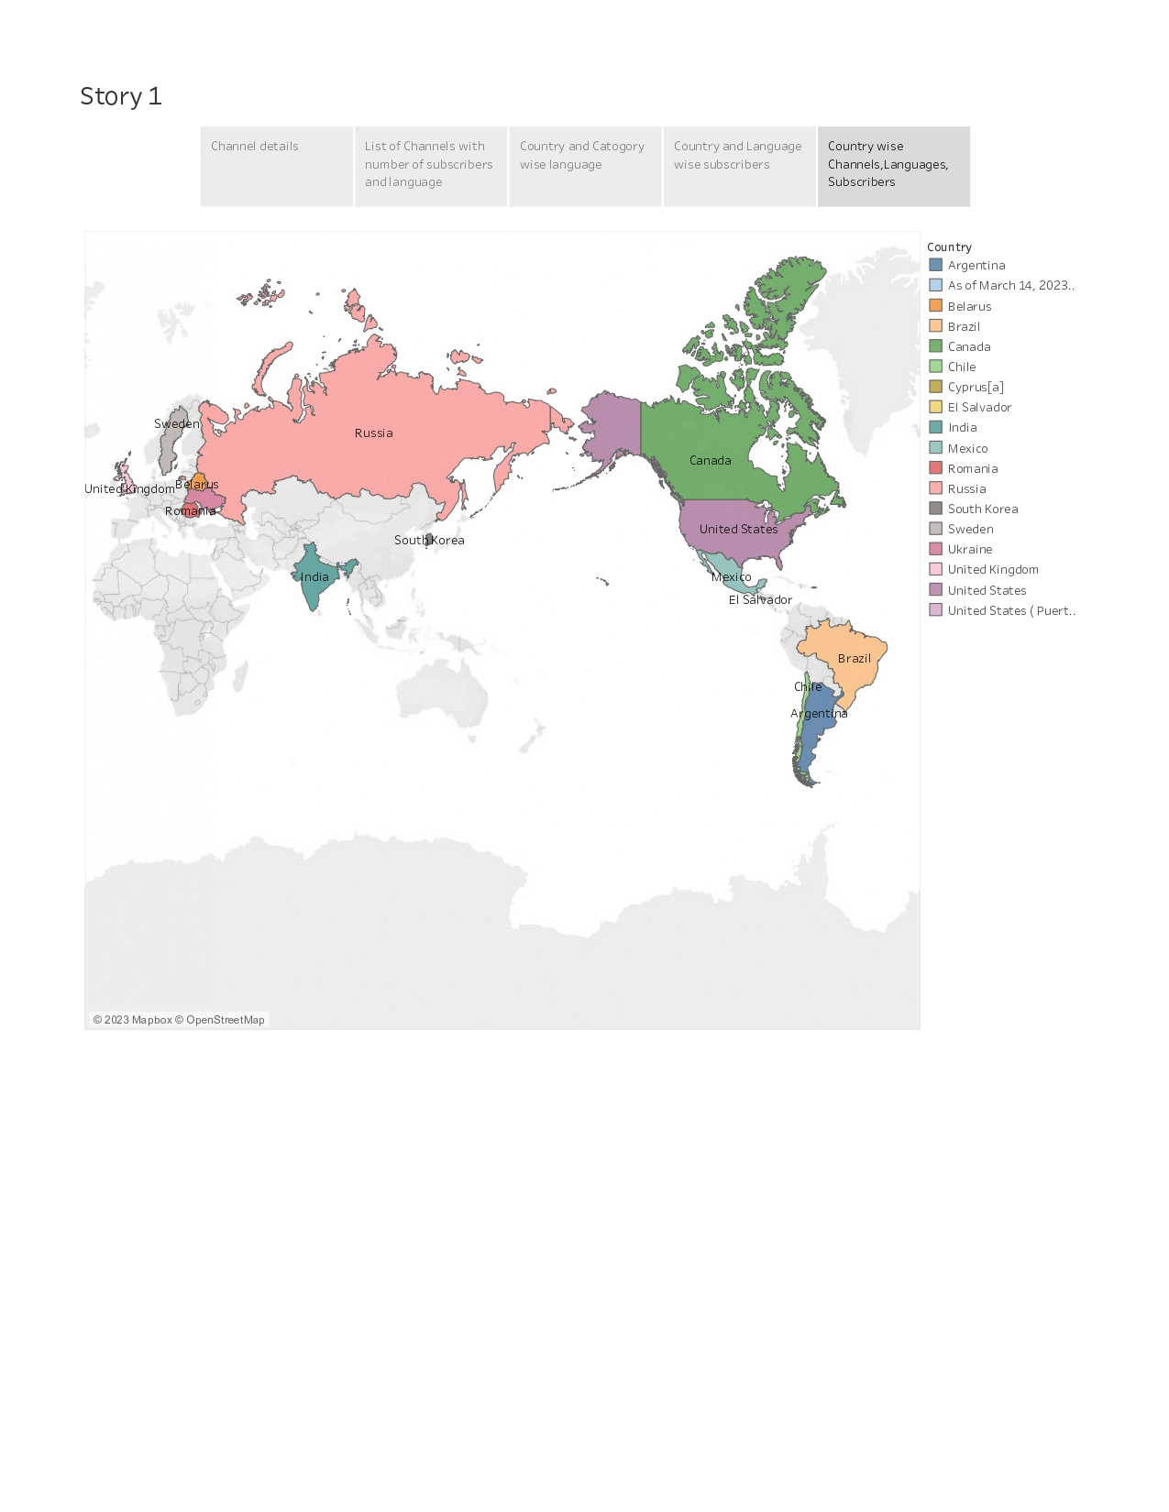
STORY CAPTION 5

Slide 18
ADVANTAGE
Content Variety: Channels can cover a wide range of topics, catering to diverse interests and audiences.
Accessibility: Content is available 24/7, allowing viewers to watch at their convenience.
Engagement: Viewers can like, comment, and subscribe, fostering a sense of community and interaction.
Monetization: Creators can earn revenue through ads, sponsorships, and merchandise sales.
Educational Value: Many channels provide informative and educational content.
Entertainment: Channels offer entertainment through vlogs, music, gaming, and more.
Global Reach: YouTube has a vast international audience, expanding a channel's reach.
Creative Expression: It allows creators to express their ideas, talents, and creativity.
Analytics: Creators have access to data on their audience, helping them refine content.
Long-term Potential: Successful channels can become sustainable businesses.

Slide 19
DISADVANTAGE
*Copyright Claims:* Creators may face copyright claims or strikes if they use copyrighted material without proper permission.
*Content Theft:* Others may steal or re-upload a creator's content without authorization.
*Ad Revenue Dependency:* Relying solely on ad revenue can be risky due to fluctuations in CPM (cost per thousand views).
*Changing Algorithms:* Frequent changes in YouTube's algorithms can impact a channel's visibility and discoverability.
*Technical Challenges:* Creators may encounter technical issues with equipment, software, or connectivity.
*Negative Feedback:* Dealing with criticism and negative comments can be emotionally draining.
*Limited Control:* Creators have limited control over changes YouTube makes to its platform.
*Inconsistent Growth:* Channel growth may be slow, unpredictable, or plateau at times.
*Pressure to Produce:* Creators may feel pressured to constantly produce content, impacting work-life balance.
*Competition from Established Channels:* Established channels can make it difficult for new creators to gain a foothold in their niche.

Slide 20
CONCLUSION
YouTube has become a powerful platform for individuals and businesses to build influence and connect with a wide audience. By analyzing the top YouTube channels and their mass appeal to subscribers, we can learn valuable lessons about creating successful content and leveraging the power of influence for personal or business purposes.
Good luck!

